Slide 1
Business Process Engineering
Business Process Outsourcing Strategies
Lecture: 21
Instructor: Salman Ahmad

Slide 2
BPO
In BPO, a client’s business process is performed by a vendor.
Vendors become the “Back office”
Vendors are given certain responsibilities
Vendors need to have the capability to provide consistent levels of customer service spanning across a range of services and businesses
Notes:
Outsourcing is not new. Even in Roman empire tax collection from far flanged areas was outsourced

Slide 3
How to BPO
General idea is to split the organization’s processes into two categories
Core
  Where core competencies are strong
  Have strategic significance
  Best done in-house
Other
  That can be performed by vendor
Notes:
Importantly, the market is dynamic where the demands and competition changes over time
and, therefore, the core competencies or the strategic nature of associated business processes
may accordingly change. Hence, organizations also need to have a clear vision of their
goals and future strategy in the dynamic marketplace and, accordingly, identify its business
processes for outsourcing. Failure to do so can make an organization overly dependent on
the BPO vendors for its core or strategic business processes, and it would effectively be
at the mercy of vendors. The key here is to have complete power and control over one’s
core and strategic business processes, while gaining maximum advantages out of the various
vendors’ strengths in noncore business processes.

Slide 4
Strategies of Outsourcing
In-sourcing
  The business processes are performed by the client itself or a client entity
Out-sourcing
  The business processes are performed by a nonclient entity

Slide 5
In-Sourcing
OK as is
Outsourcing
Divest
Fix & Keep in-house
Option to reverse

Slide 6
How to Decide?
In-sourcing vs Out-sourcing

Slide 7
Advantages of In-sourcing
Insourcing allows greater control over the strategic assets and resources that are used in the business processes
Possibility of opportunistic behaviour of a vendor is a major hassle, and insourcing safeguards against this risk
Insourcing is best when high uncertainty is associated with the business process
Working with Institutional Knowledge
Risk of IP is reduced

Slide 8
Advantages of Out-sourcing
Can lead to considerable cost advantage
Allows to focus of core business
More flexibility

Slide 9
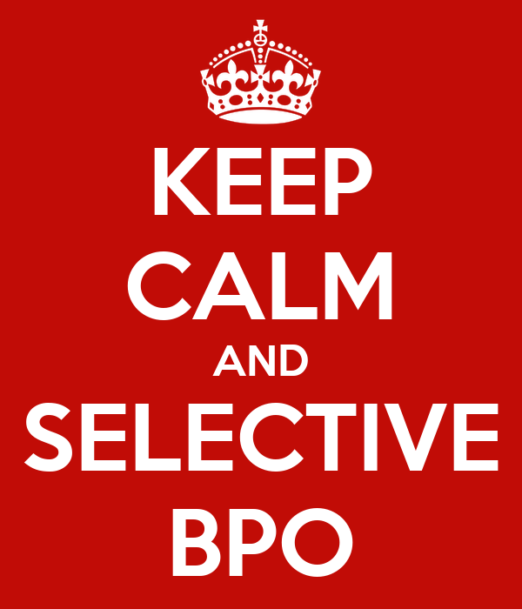
Should we out source everything?

Slide 10
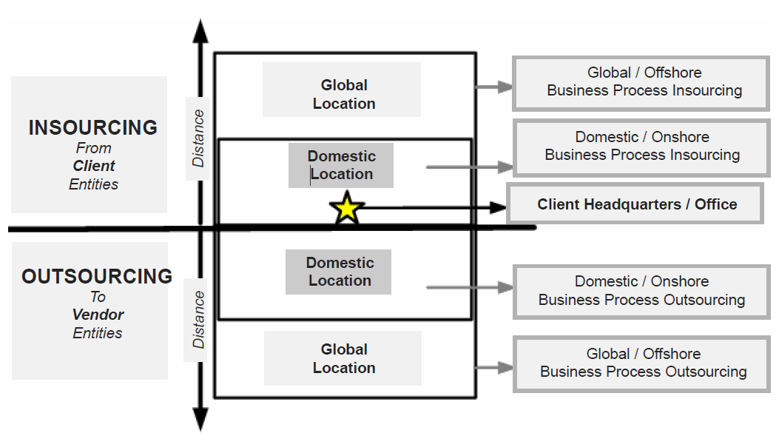
Strategies

Slide 11
Offshore Outsourcing
Business can run 24/7
Cost savings
Use of modern/state of the art technology
Business process maturity and quality improvement

Slide 12
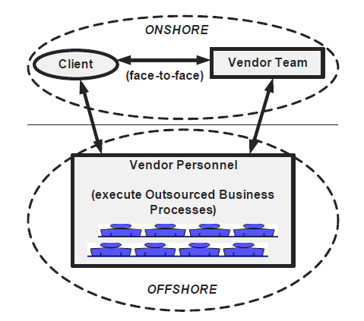
Distributed Delivery
Notes:
TCS, Infosys, SAP

Slide 13
Strategy for Business Process Migration
Assessment
Transition
Parallel Run
Steady State

Slide 14
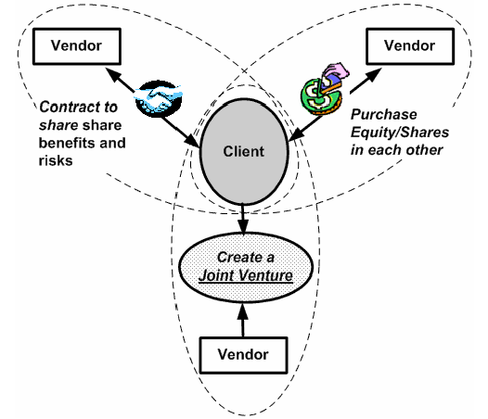
Strategy for Shared Ownership

Slide 15
Chapter 11 - E-Business Process Management_ Technologies and Solutions-IGI Global (2007)
  Jayavel Sounderpandian, Jayavel Sounderpandian and Tapen Sinha

